Slide 1
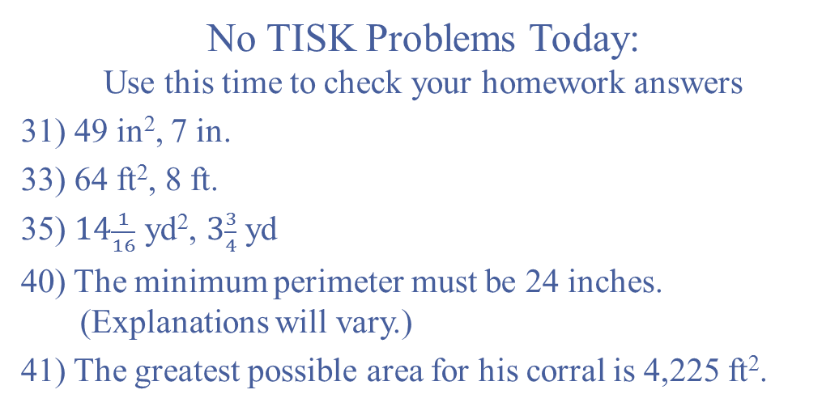
Thursday, August 9, 2012
No TISK Problems Today:
Use this time to check your homework answers
31) 49 in², 7 in.
33) 64 ft², 8 ft.
35) $14\frac{1}{16}$ yd², $3\frac{3}{4}$ yd
40) The minimum perimeter must be 24 inches.
(Explanations will vary.)
41) The greatest possible area for his corral is 4,225 ft².

Slide 2

Measuring Segments
Before we begin…
  Postulates
  Theorems
  Definitions
  $≅$ vs. $=$

Slide 3
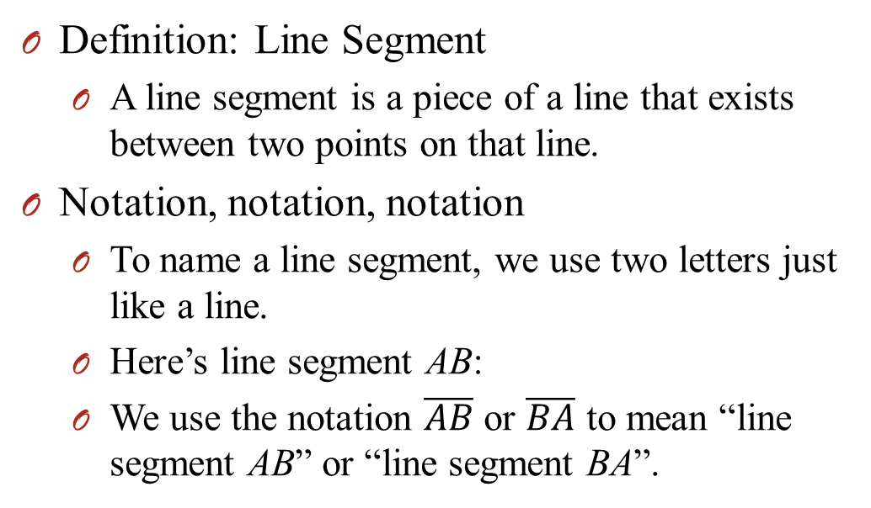
Measuring Segments
Definition: Line Segment
  A line segment is a piece of a line that exists between two points on that line.
Notation, notation, notation
  To name a line segment, we use two letters just like a line.
  Here’s line segment AB:
  We use the notation $\overline{AB}$ or $\overline{BA}$ to mean “line segment AB” or “line segment BA”.
A
B

Slide 4
Postulates
Ruler Postulate
  All points on a line can be matched “one to one” with the real numbers. The real number that corresponds to a point is the coordinate of the point.
  The distance between two points, A and B, is written as AB, and is equal to the absolute value of the difference between the coordinates of A and B.
  AB is also called the length of

Slide 5
Postulates
Segment Addition Postulate
If B is between A and C,
then AB + BC = AC.
If AB + BC = AC,
then B is between A and C.
A
B
C

Slide 6
Formula
Distance Formula
  If are points in a coordinate plane, then the distance between A and B is

Slide 7
Why does it work?
It is based on the Pythagorean Theorem and the Ruler Postulate!
A
c
b
C
a
B

Slide 8
Why?
A
c
a
B
b

Slide 9
Homework
p. 33-34 #22-30 even, 35-37 all, 38-44 even, 47 & 48

